Slide 1
SWIM Short Course SEAWAT Concepts
2018 Salt Water Intrusion Meeting
June 17 – 22, 2018
Gdansk, Poland

Slide 2
SEAWAT Computer Program
Finite difference
Combined version of MODFLOW and MT3DMS
Designed to simulate transient, three-dimensional, fully saturated, variable-density groundwater flow coupled with multi-species transport

Slide 3
Approaches for Representing Variable-Density Flow
Ignore it!
Sharp interface approach
Fully coupled flow and dispersive transport approach

Slide 4
Classes of Variable-Density Models
Sharp Interface Approach
Fast
No dispersion
Dispersed Interface Approach
Can predict changes in concentration
Represent free convection processes
Slow

Slide 5
SEAWAT Applications
Saltwater intrusion
Coastal groundwater flow
Aquifer storage and recovery
Deep well injection
Heat transport

Slide 6
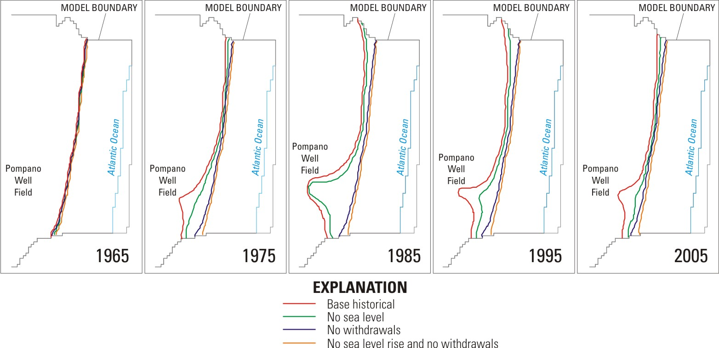
Saltwater Intrusion

Slide 7
Salinity / Heat Transport

Slide 8
SEAWAT Results
CASE A

Slide 9

Aquifer Storage and Recover

Slide 10
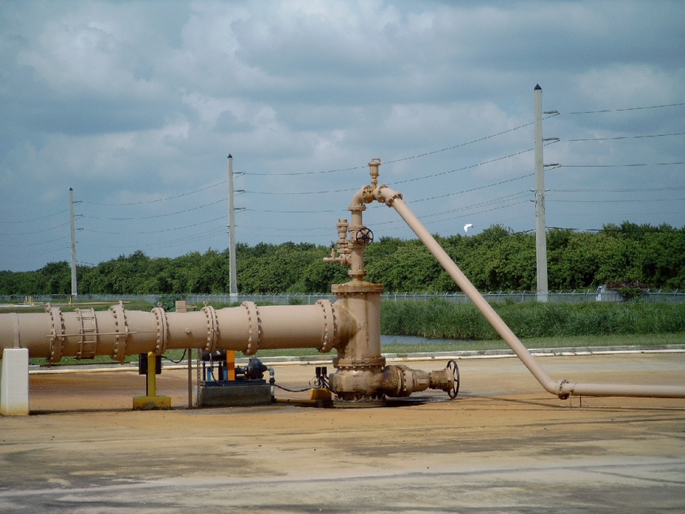
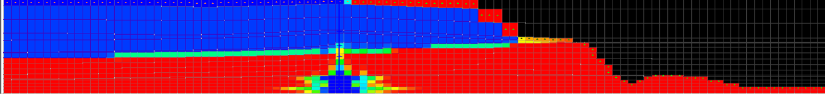
Deep Well Injection

Slide 11
Why use SEAWAT?
Accurate
Documented
Public domain
Relatively easy to use
Based on MODFLOW and MT3D
Modular—Process/Package approach
Compatible with existing pre and post processors
Compatible with a wide range of utility programs (MODPATH, ZONEBUDGET, etc)

Slide 12
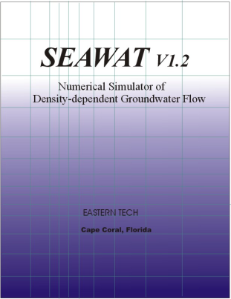
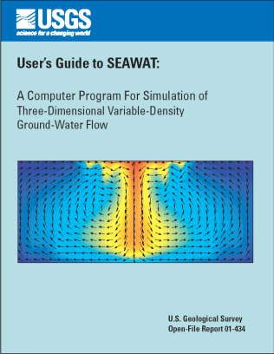
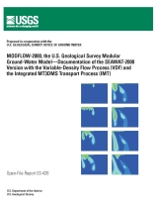
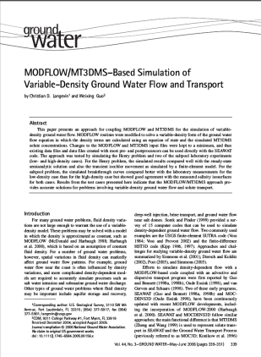
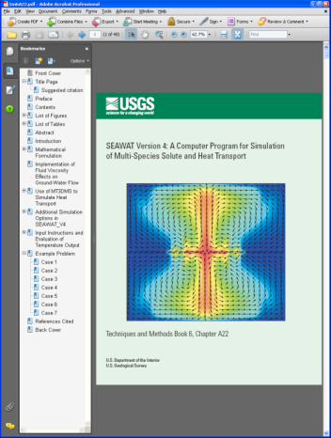
Documentation
Version 1
Guo, W., and Bennett, G.D., 1999, SEAWAT Version 1.2: A computer program for simulations of groundwater flow of variable density: Eastern Tech, Cape Coral, Florida.
Version 2
Guo, W., and Langevin, C.D., 2002, User’s guide to SEAWAT: A computer program for simulation of three-dimensional variable-density ground-water flow: U.S. Geological Survey Techniques of Water Resources Investigations Book 6, Chapter A7, 79 p.
Version 3
Langevin, C.D., Shoemaker, W.B., and Guo, Weixing, 2004, MODFLOW-2000, the U.S. Geological Survey Modular Ground-Water Model–Documentation of the SEAWAT-2000 Version with the Variable-Density Flow Process (VDF) and the Integrated MT3DMS Transport Process (IMT): U.S. Geological Survey Open-File Report 03-426, 43 p.
Langevin, C.D., and Guo, W., 2006. MODFLOW/MT3DMS-based simulation of variable density ground water flow and transport: Ground Water vol. 44, no. 3:339-351.
Version 4
Langevin, C.D., Thorne, D.T., Dausman, A.M., Sukop, M.C., and Guo, Weixing, 2008, SEAWAT Version 4: A computer program for simulation of multi-species solute and heat transport. U.S. Geological Survey Techniques and Methods Book 6, Chapter A22, 39 p.

Slide 13
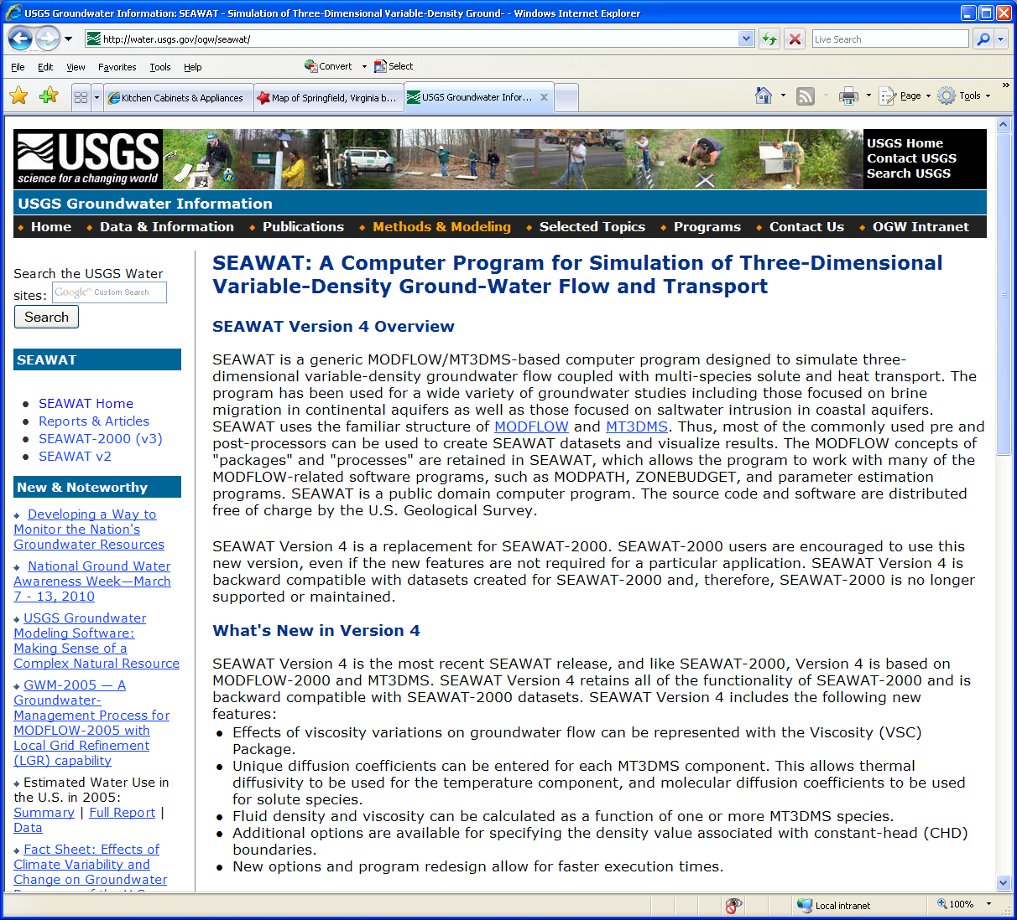
Public Domain
http://water.usgs.gov/ogw/seawat

Slide 14
SEAWAT Concept
Combine MODFLOW and MT3DMS into a single program
Insert MT3DMS into MODFLOW main program
Modify MODFLOW routines to solve the variable-density groundwater flow equation

Slide 15
Fluid Density (ρ)
Total Mass (fluid and salt) / Volume
Dimensions [ML⁻³]
Commonly denoted with ρ
Typical Values for Water
Fresh: ρ = 1000 kg/m³
Seawater: ρ = 1025 kg/m³

Slide 16
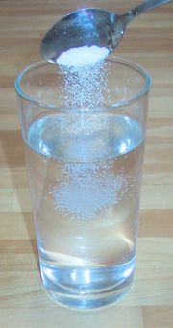
Solute Concentration (C)
Solute volumetric concentration (C)
Mass of solute / volume of fluid

Slide 17
Head-Based Formulation?
Many variable-density codes solve equations in terms of pressure, but equations can also be formulated using head
Why head instead of pressure?
Perhaps more intuitive
Use popular codes, such as MODFLOW?
Complication: what is “head” in a variable-density system?

Slide 18
Measures of Head
piezometer filled
with aquifer water
at well opening
piezometer filled
with freshwater
piezometer filled
with adjacent aquifer water
h_{f}
h
h_{e}
freshwater
brackish water
seawater
point-water
head (h)
freshwater
head (h_{f})
environmental
head (h_{e})

Slide 19
Point-Water and Freshwater Head
A
B
Piezometer filled
with freshwater
Piezometer filled
with saline water
h: head
h_{f}: equivalent freshwater head
P: pressure
ρ: density
ρ _{f} : density of freshwater
g: gravity
Z: elevation
N
Datum

Slide 20
Converting between h_{f} and h

Slide 21
Why use h_{f} in SEAWAT?
Conceptually straightforward (i.e. for freshwater system, h_{f} = h)
Finite-difference form of governing equation can be solved by MODFLOW (with a few modifications)

Slide 22
Darcy’s Law
equivalent freshwater head and hydraulic conductivity
pressure and permeability
can assume

Slide 23
Governing Equation for Variable-Density Flow
or

Slide 24
Governing Equation for Solute Transport
ADV
DSP
SSM
RCT

Slide 25
Coupled Flow and Transport
Groundwater flow is affected by fluid density
q = f(ρ,…)
Concentration is affected by flow velocity (advection and dispersion)
C = f(q,…)
Fluid density is function of solute concentration
ρ = f(C)

Slide 26
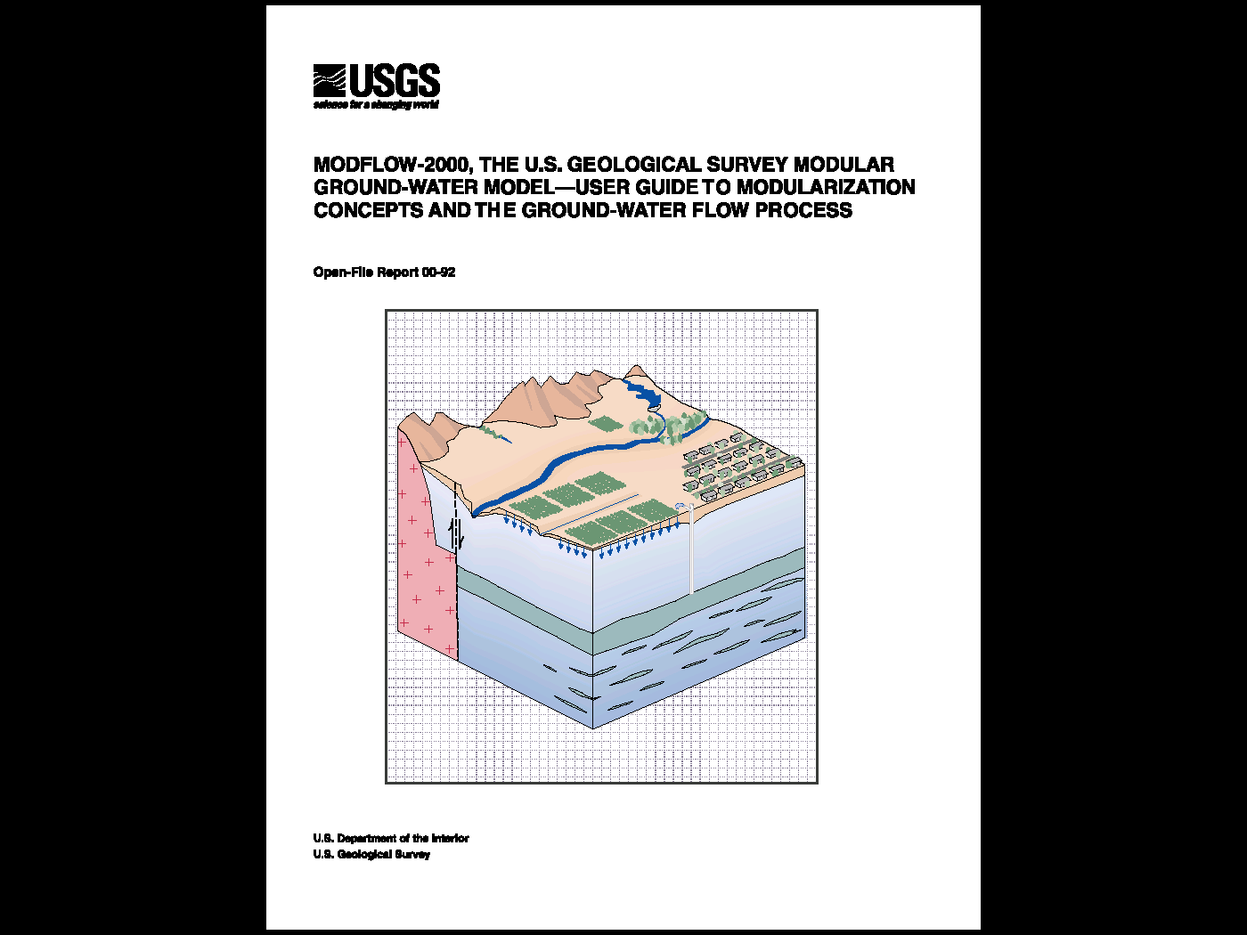
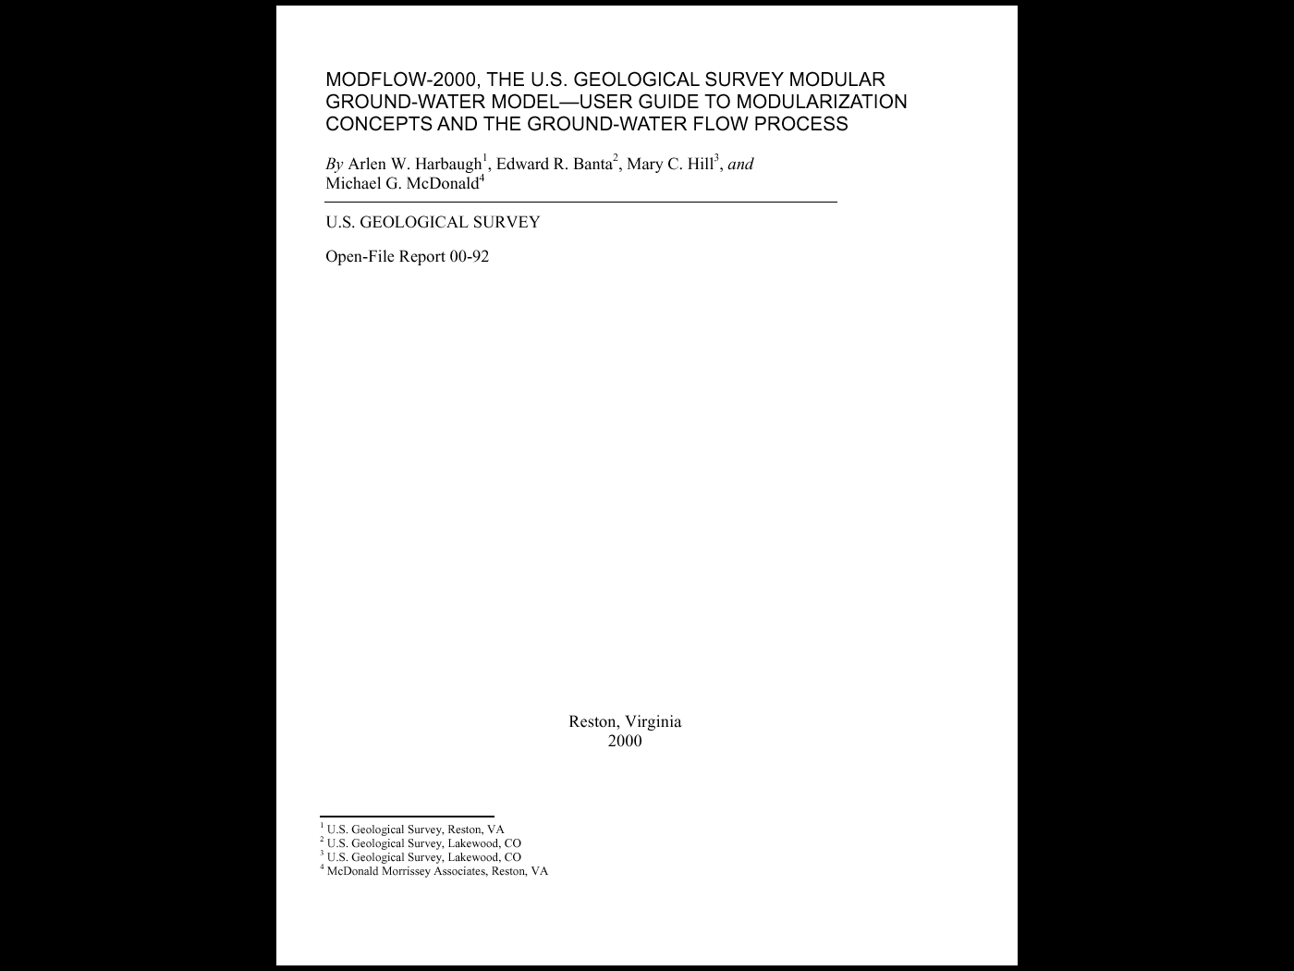
MODFLOW-2000
http://water.usgs.gov/software/modflow.html

Slide 27
List of Packages (included with MF2K version 1.17)
BAS6 -- Basic Package
BCF6 -- Block-Centered Flow Package
LPF1 -- Layer-Property Flow Package
RIV6 -- River Package
DRN6 -- Drain Package
WEL6 -- Well Package
GHB6 -- General Head Boundary Package
RCH6 -- Recharge Package
EVT6 -- Evapotranspiration Package
CHD6 -- Time-Variant Specified-Head Package
HFB6 -- Horizontal Flow Barrier Package
SIP5 -- Strongly Implicit Procedure Package
SOR5 -- Slice Successive Over-Relaxation Package
PCG2 -- Version 2 of Preconditioned Conjugate Gradient Package
DE45 -- Direct solver
LMG1 -- Multigrid solver (for USGS use only)
STR6 -- Streamflow-Routing Package
ADV2 -- Advective-Transport Observation Package
RES1 -- Reservoir Package (RES is the file type in the MODFLOW name file)
FHB1 -- Flow and Head Boundary Package (FHB is the file type in the MODFLOW name file)
IBS6 -- Interbed Storage (subsidence) Package (IBS is the file type in the name file)
HUF2 -- Hydrogeologic-Unit Flow Package
LAK3 -- Lake Package
ETS1 -- Evapotranspiration with a Segmented Function Package
DRT1 -- Drains with Return Flow Package
LMT6 -- Link to MT3DMS contaminant-transport model
MNW1 -- Multi-Node Well Package
DAF1 -- Diffusion Analogy Surface-Water Flow Package
SUB1 -- Subsidence and Aquifer-System Compaction Package
SFR2 -- Stream-Flow Routing Package, version 2
GMG1 -- Geometric MultiGrid Solver Package
Bold indicates package not compatible with SEAWAT-2000

Slide 28
Solute Transport Processes
Physical Transport of solute
Advection
Diffusion
Mechanical Dispersion
Reactive Transport
Geochemical reactions
Biological reactions

Slide 29
Governing Equation for Solute Transport
ADV
DSP
SSM
RCT
Or, as in MT3DMS
DSP
ADV
SSM
RCT

Slide 30
MT3DMS File Structure
INPUT
OUTPUT
Basic Transport Package
Basic Output File
Advection Package
Model Configuration File [mt3d.cnf]
Dispersion Package
Hydrocarbon Spill Source – v. 5.3
MT3DMS
Unformatted Concentration File [mt3d001.ucn]
Sink/Source Mixing Package
Transport Observations Package
Observation File [mt3d001.obs]
Reaction Package
GCG Solver Package
Mass Summary File [mt3d001.mas]
MODFLOW to MT3DMS link file
Courtesy Chunmiao Zheng

Slide 31
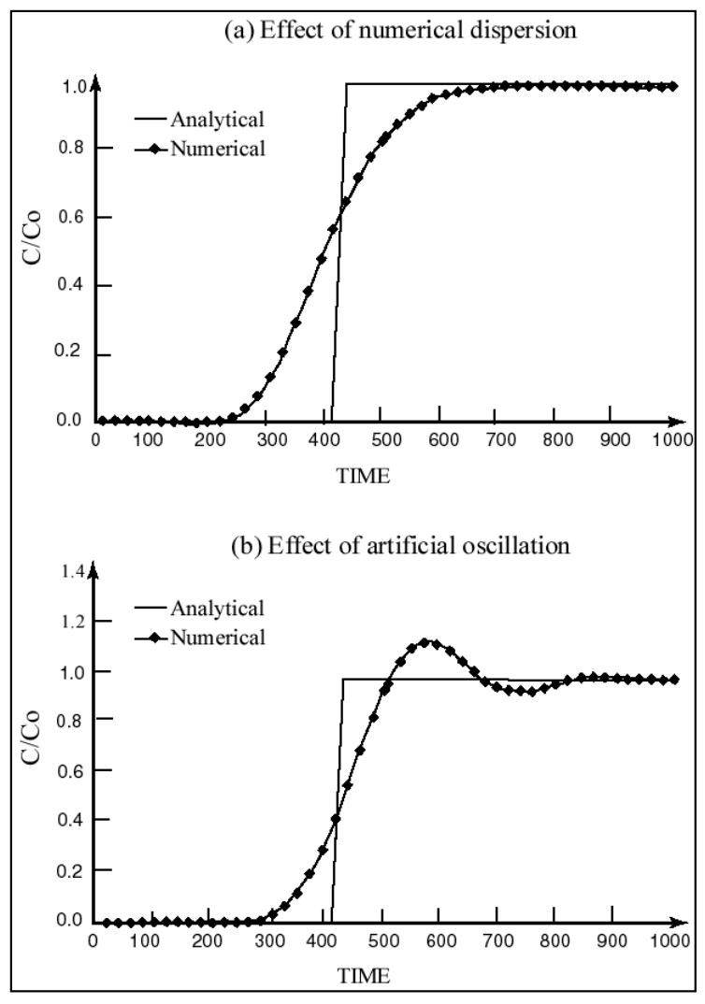
Numerical Issues

Slide 32
Solution Methods
Eulerian
Fixed grid (standard finite difference or finite element)
Lagrangian
Deforming grid or deforming coordinate in a fixed grid (particle based)
Mixed Eulerian-Lagrangian
Combination of Eulerian and Langrangian methods

Slide 33
BTN Package
Purpose: to specify
Basic information
Spatial discretization
Boundary and initial conditions
Printing and saving options
Temporal discretization
Courtesy Chunmiao Zheng

Slide 34
Temporal Discretization
Stress periods
Flow timesteps
Transport timesteps
Transport timesteps
1
2
3
4
5
1
2
3
4
1
2
3
4
1
2
3
4
1
1
2
1
1
2
1
2
3
ts1
ts1
ts2
ts3
ts1
ts2
ts3
ts4
ts5
time
STRESS PERIOD 1
STRESS PERIOD 2
STRESS PERIOD 3

Slide 35
Advection
Transport of solute in flowing groundwater with average groundwater velocity
In most cases, advection is primary process for solute transport

Slide 36
ADV Package
Purpose
To solve the advection components of the transport equation using one of the following options (through input variable MIXELM)
Finite Difference
Upstream weighting
Central-in-space weighting
Particle-Based Methods
MOC
MMOC
HMOC
TVD
Courtesy Chunmiao Zheng

Slide 37
Courant Number
Number of cells, or fractional cell distance, that a particle is advected in one timestep

Slide 38
Method of Characteristics (MOC)
Each particle carries a volume and a concentration
Courtesy Chunmiao Zheng

Slide 39
Advantages and Limitation of Particle Methods
Advantages
Virtually eliminate numerical dispersion
Computationally efficient for highly advection-dominated problems
Disadvantages
May have mass balance discrepancy problems, particularly when model grid is highly irregular
Calculated concentration breakthrough curves may be “rough”
Computer memory intensive, particularly for multi-species simulations, with a set of particles for each species
Courtesy Chunmiao Zheng

Slide 40
Advantages and Disadvantages of TVD
Advantages
Mass conservative
Minimal numerical dispersion and artificial oscillation for advection dominated problems
No numerical difficulty for distorted model grids or in the presence of many sinks/sources
Disadvantages
Could be computationally demanding
May not be as effective as MOC in eliminating numerical dispersion for purely advective problems
Courtesy Chunmiao Zheng

Slide 41
Dispersion
Spreading of a solute over a greater area than would be predicted solely from average groundwater velocity
v Δ t₂
vΔt₁
Longitudinal dispersion
Transverse dispersion

Slide 42
Mechanical Dispersion
Spreading of solute as a result of differences in actual velocity and average velocity
Pore Scale
Macro Scale

Slide 43
Molecular Diffusion
(A) Container with saline water and distilled water separated by a glass plate
(B) Ionic distribution after removal of glass plate
Spread of solute caused by concentration gradients
(C) Ionic distribution at time t1 after removal of plate
(D) Final ionic distribution

Slide 44
DSP Package
Purpose: to solve the dispersion component of the transport equation, using the finite-difference technique
User enters
Longitudinal dispersivity
Transverse dispersivity
Molecular diffusion coefficient

Slide 45
SSM Package
Represent source and sink mixing
Point sinks/sources
Constant-head cells (ITYPE=1)
Wells (ITYPE=2)
Drains (ITYPE=3)
Rivers (ITYPE=4)
General-head boundaries (ITYPE=5)
…
Mass loading (ITYPE=15)
Distributed sinks/sources
Recharge
Evapotranspiration
Courtesy Chunmiao Zheng

Slide 46
SSM Package (cont.)
Specify concentrations of sinks/sources
Sinks
By default, concentration of all sinks set equal to that of aquifer at sink/cell locations
Default concentration of all sinks cannot be changed except for evapotranspiration
Sources
By default, concentration of all sources set equal to ZERO unless specified by user
Courtesy Chunmiao Zheng

Slide 47
Generalized Conjugate Gradient (GCG) Solver
Required
General purpose iterative solver
Several preconditioning options
Lanczos/ORTHOMIN acceleration scheme
Two iteration loops (outer loop only required if matrix coefficients are a function of concentration: non-linear sorption)

Slide 48
SEAWAT Processes
Global (GLO) Process
Ground-Water Flow (GWF) Process
Variable-Density Flow (VDF) Process
Viscosity (VSC) Package
Integrated MT3DMS Transport (IMT) Process
Observation (OBS) Process
Sensitivity (SEN) Process
Parameters Estimation (PES) Process

Slide 49
Optional Simulation Mode: VDF without Transport
User enters 3D array of fluid density
Caution—assumption is that fluid density will not change during the simulation period
Advantage: simulations run quickly because not limited by stability requirements for transport equation

Slide 50
Spatial Discretization
Information must be consistent between MODFLOW and MT3D
Higher level of vertical discretization required for variable-density groundwater flow (rule of thumb—~10 layers per aquifer)

Slide 51
Temporal Discretization
Stress periods
Flow timesteps
Transport timesteps
Flow and transport equations solved for each transport timestep
Transport timesteps
1
2
3
4
5
1
2
3
4
1
2
3
4
1
2
3
4
1
1
2
1
1
2
1
2
3
ts1
ts1
ts2
ts3
ts1
ts2
ts3
ts4
ts5
time
STRESS PERIOD 1
STRESS PERIOD 2
STRESS PERIOD 3

Slide 52
Name File
Name file is requested when SEAWAT Version 4 runs
Contains filetype, unit number, filename
Contains file information for:
MODFLOW-2000 files
MT3DMS files
Variable-Density Flow (VDF) input file
Viscosity Package (VSC) input file [optional]
Flopy creates valid SEAWAT Version 4 name file

Slide 53
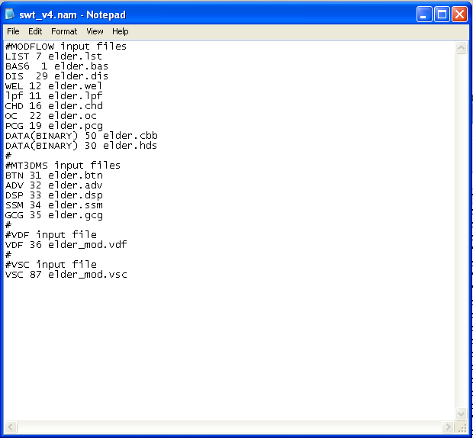
Example Name File

Slide 54
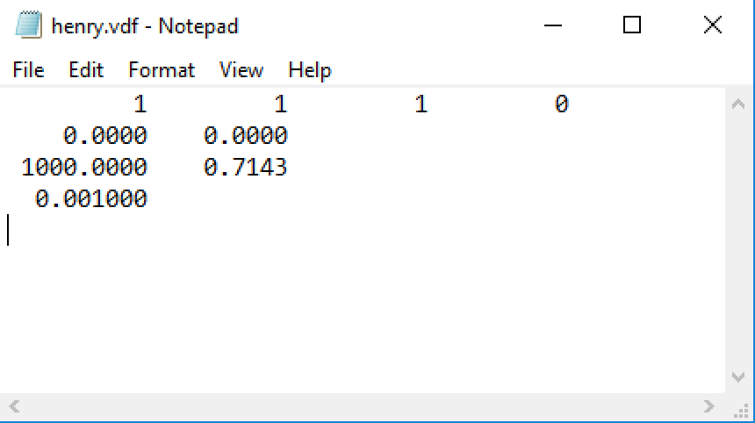
VDF File

Slide 55
DENSEREF and DENSESLP
Concentration
units | freshwater | seawater
mg/L | 0 | 35,000
g/L | 0 | 35
lbs/ft³ | 0 | 2.188
relative | 0 | 1
Density
units | Freshwater (DENSEREF) | seawater
g/cm³ | 1 | 1.025
kg/m³ | 1000 | 1025
lbs/ft³ | 62.42 | 63.98
Example:
use concentration in mg/L and density in kg/m³
Density length units must be same as length units used for model grid, hydraulic conductivity, etc.

Slide 56
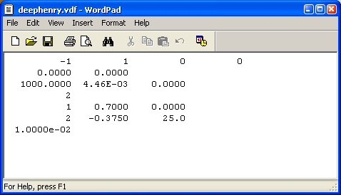
Density Equation of State
Multiple-species
Temperature
Water Compressibility

Slide 57
Special Considerations for Packages
All input and output is expressed in terms of head (not equivalent freshwater head)
All storage and hydraulic properties must be represented in terms of equivalent freshwater values (or relative to the reference density)

Slide 58
Model Results of Interest
Listing Files
Flow budget
Solute mass budget
Heads
Flows
Concentrations
Unformatted concentration file
Concentration observations
Solute mass budget

Slide 59
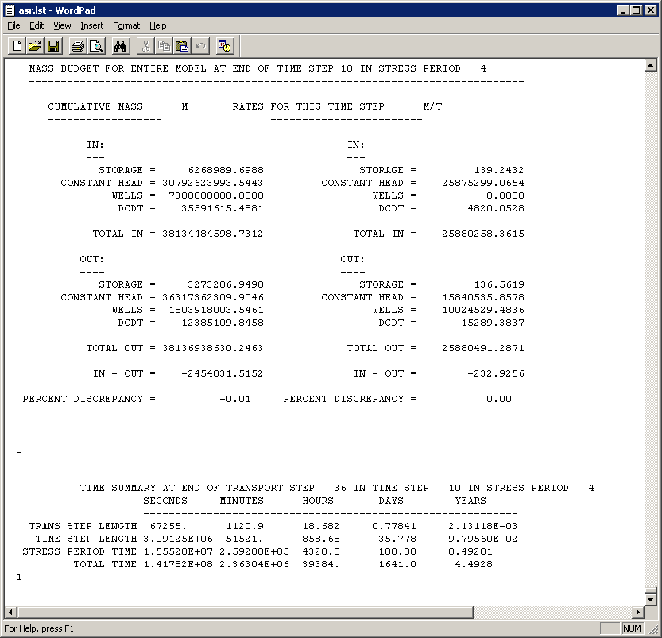
Flow Budget

Slide 60
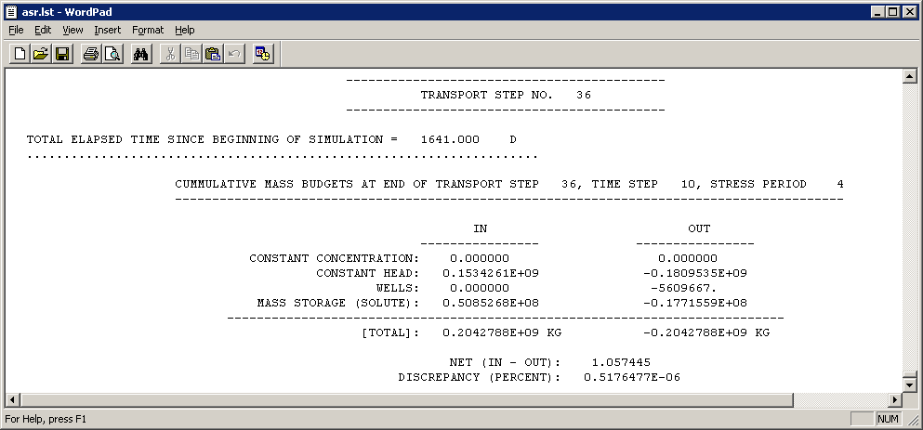
Solute Budget

Slide 62
Heat Transport

Slide 63
Heat/Energy Transport (conserve Energy/Mass)
Stored
Conducted and Dispersed
Convected
Sink/Source
RCT(produced/lost)

Slide 64
Heat transport…
Solute transport…

Slide 65
Equation of State
Equation of state is used to relate fluid density to pressure, temperature, and concentration
Most rigorous form:
ρ = ρ ₀exp[B_{P}(P-P₀) + B_{T}(T-T₀)+Β_{C}(C-C₀)]
Β_{P} = 1/ ρ*δρ/δP|_{T,C} (fluid compressibility)
Β_{T} = 1/ ρ*δρ/δT|_{P,C} (fluid coefficient of thermal expansion)
Β_{C} = 1/ ρ*δρ/δC|_{P,T} (slope of fluid density as a function of solute concentration, divided by reference density)
A linear approximation is often used, which can be written as:
ρ = ρ ₀[1 + B_{P}(P-P₀) + B_{T}(T-T₀)+Β_{C}(C-C₀)], or
ρ = ρ ₀+ dρ/dP* (P-P₀) + dρ/dT* (T-T₀) + dρ/dC* (C-C₀)]
In SEAWAT, we assume that density is not affected by pressure or temperature, and that the reference density is freshwater with a concentration of zero
ρ = ρ _{f} + dρ/dC * C
DENSE = DENSEREF + DENSESLP * CONC
Value for dρ/dC is about 0.7143 (25/35) for a freshwater-seawater mixture, if density and concentration are expressed in equivalent units
Note: parts of this taken from Kipp (1987), Kolditz et al. (1998) and Diersch and Kolditz (2002)

Slide 66
VSC Input File
By including in name file will activate the VSC option
VSC file is created by FloPy
Have multiple options from manual
Concentration
Temperature

Slide 67
VSC File
FOR EACH SIMULATION
0. [#Text]
Item 0 is optional and the symbol # must be in column 1. Item 0 can be repeated multiple times.
1. MT3DMUFLG
2. VISCMIN VISCMAX
Read item 3 if MT3DMUFLG ≥ 0
3. VISCREF DMUDC(1) CMUREF(1)
Read item 3a through 3c if MT3DMUFLG = -1
3a. VISCREF
3b. NSMUEOS MUTEMPOPT
3c. MTMUSPEC(NSMUEOS) DMUDC(NSMUEOS) CMUREF(NSMUEOS)
Item 3c is read NSMUEOS times, once for each MT3DMS species to be included in the viscosity equation.
3d. MTMUTEMPSPEC AMUCOEFF(MUNCOEFF)
Item 3d is read if MUTEMPOPT > 0. The size of the AMUCOEFF coefficient array depends on the selected equation for viscosity.
FOR EACH STRESS PERIOD
Read items 4 and 5 only if MT3DMUFLG = 0
4. INVISC
Read item 5 only if INVISC is greater than zero
5. [VISC(NCOL,NROW)] – U2DREL
Item 5 is read for each layer in the grid.

Slide 68
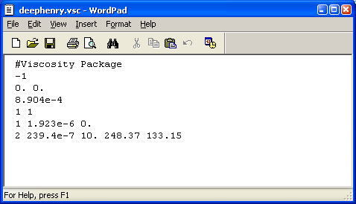
Constitutive Relation for Viscosity
or
MUTEMPOPT
1
2
3
e.g. SUTRA

